Slide 1
Data, Environment and Society Lecture 4: More pandas
September 10, 2018
Instructor: Duncan Calllaway
GSI: Salma Elmallah

Slide 2
Announcements
Lab 2 due next Monday
HW1 due Thursday

Slide 3
Today…
We’ll keep working with pandas. Key ideas
Merging data frames
Logical indexing
‘groupby’
See ipynb files in github repo
We’ll just talk a little about the data sets in HW2
Air quality data
I’ll use this ppt for that discussion.
Reading discussion – Kleinberg et al, Athey.

Slide 4
EPA air quality data
Here is a link to the source page.
Sources of PM
Many sizes and shapes and can be made up of hundreds of different chemicals.
Some directly from a source: construction sites, unpaved roads, fields, smokestacks or fires.
Most form in the atmosphere by complex reactions of chemicals such as sulfur dioxide and nitrogen oxides

Slide 5
More on PM2.5…
(text adapted from epa.gov) Health effects:
premature death in people with heart or lung disease
nonfatal heart attacks
irregular heartbeat
aggravated asthma
decreased lung function
increased respiratory symptoms, such as irritation of the airways
Environmental effects
makes lakes and streams acidic
changes the nutrient balance in coastal waters and large river basins
depletes soil nutrients
damages sensitive forests and farm crops
affects the diversity of ecosystems
contributes to acid rain

Slide 6
PM2.5 monitoring
Go here to see cool maps
And go here to see a list of locations
But, how many sensors?
Oakland has three
Berkeley has one, near the Marina
However as you may imagine, pollution is much more heterogeneous…

Slide 7
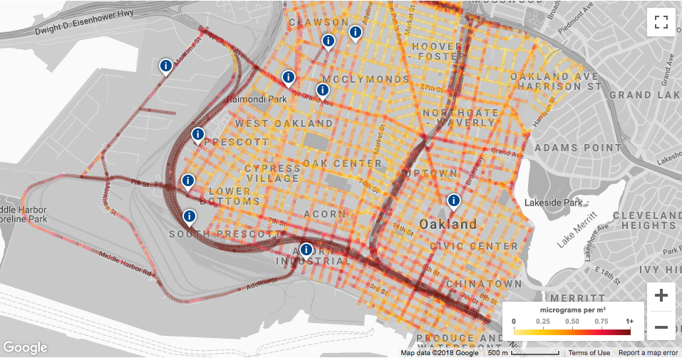
Example: Improving air quality assessments
Josh Apte (ERG PhD alum) partnered with Google, Environmental Defense and West Oakland Environmental Indicators Project to generate air quality data of unprecedented resolution

Slide 8
PurpleAir…
…sells internet-connected air quality sensors
Here is a map of where we live

